Slide 1
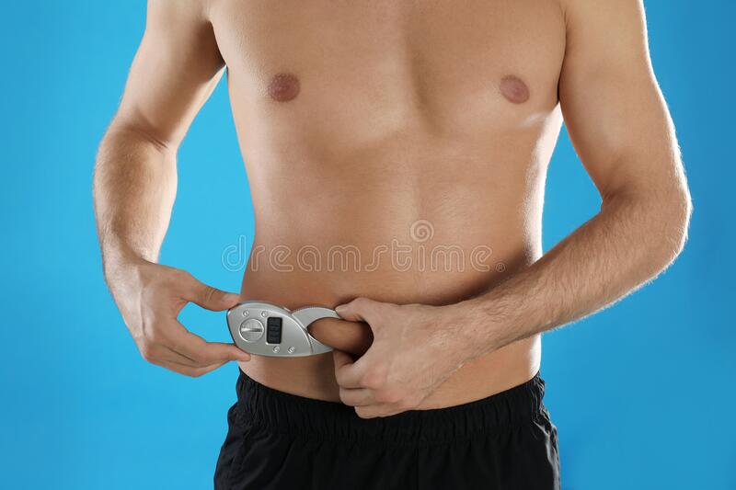
Tummy Reader
Lochana Abhayawardana

Slide 2
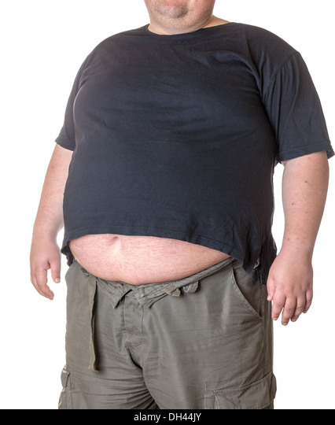

Overview
Because of the busy lifestyle people are tend to eat lot of unhealthy foods such as fast foods and foods including too much fat,sugar and calories.
Too much alcohol, smoking
Stress and poor sleep
Lack of exercises
Those reasons may dírect to gather fat in the human´s belly.
In order to maintain a healthy lifestyle we should know how many fat has gathered in your belly.
Therefore we came to an idea of designing a device to measure fat levels in human belly area.

Slide 3
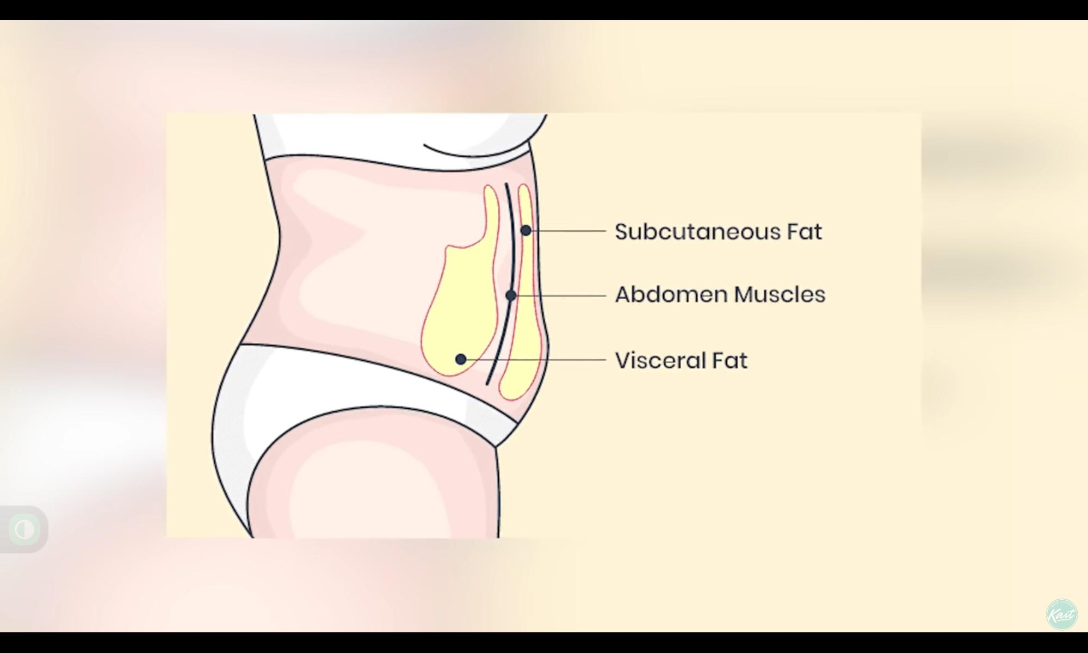
Understanding the problems
Subcutaneous fat : healthy fat
Visceral Fat : unhealthy fat
We have to figure out a way to measure visceral fat level.

Slide 4
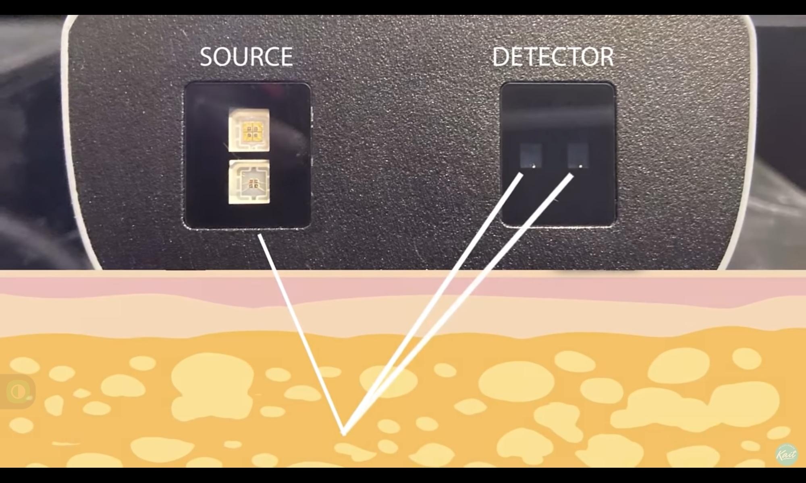
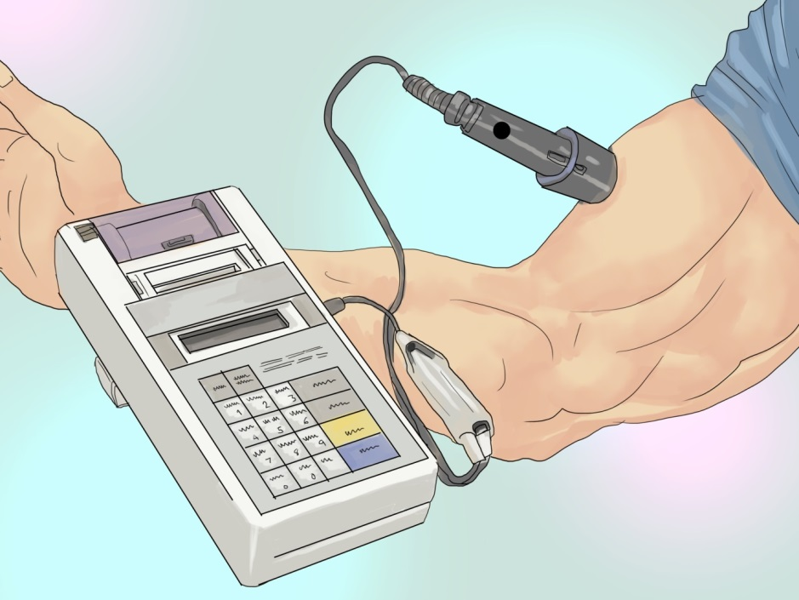
near infrared (NIR) measurement
Based on the principals of the light absorption reflectance and near infrared spectroscopy.
Ability of absorbing infrared light of the fat tissues
928 nm
Notes:
The near infrared interactance (NIR) method of assessing body composition is based on the principles of light absorption reflectance, and near infrared spectroscopy.
More specifically it is based on the ability of fat tissues to "absorb" more infrared light than lean tissue which can then be measured as a change in the infrared level.
At approximately 928 nanometers, a direct measure of how much fat exists is provided by the absorption of the infrared portion of the spectrum.

Slide 5
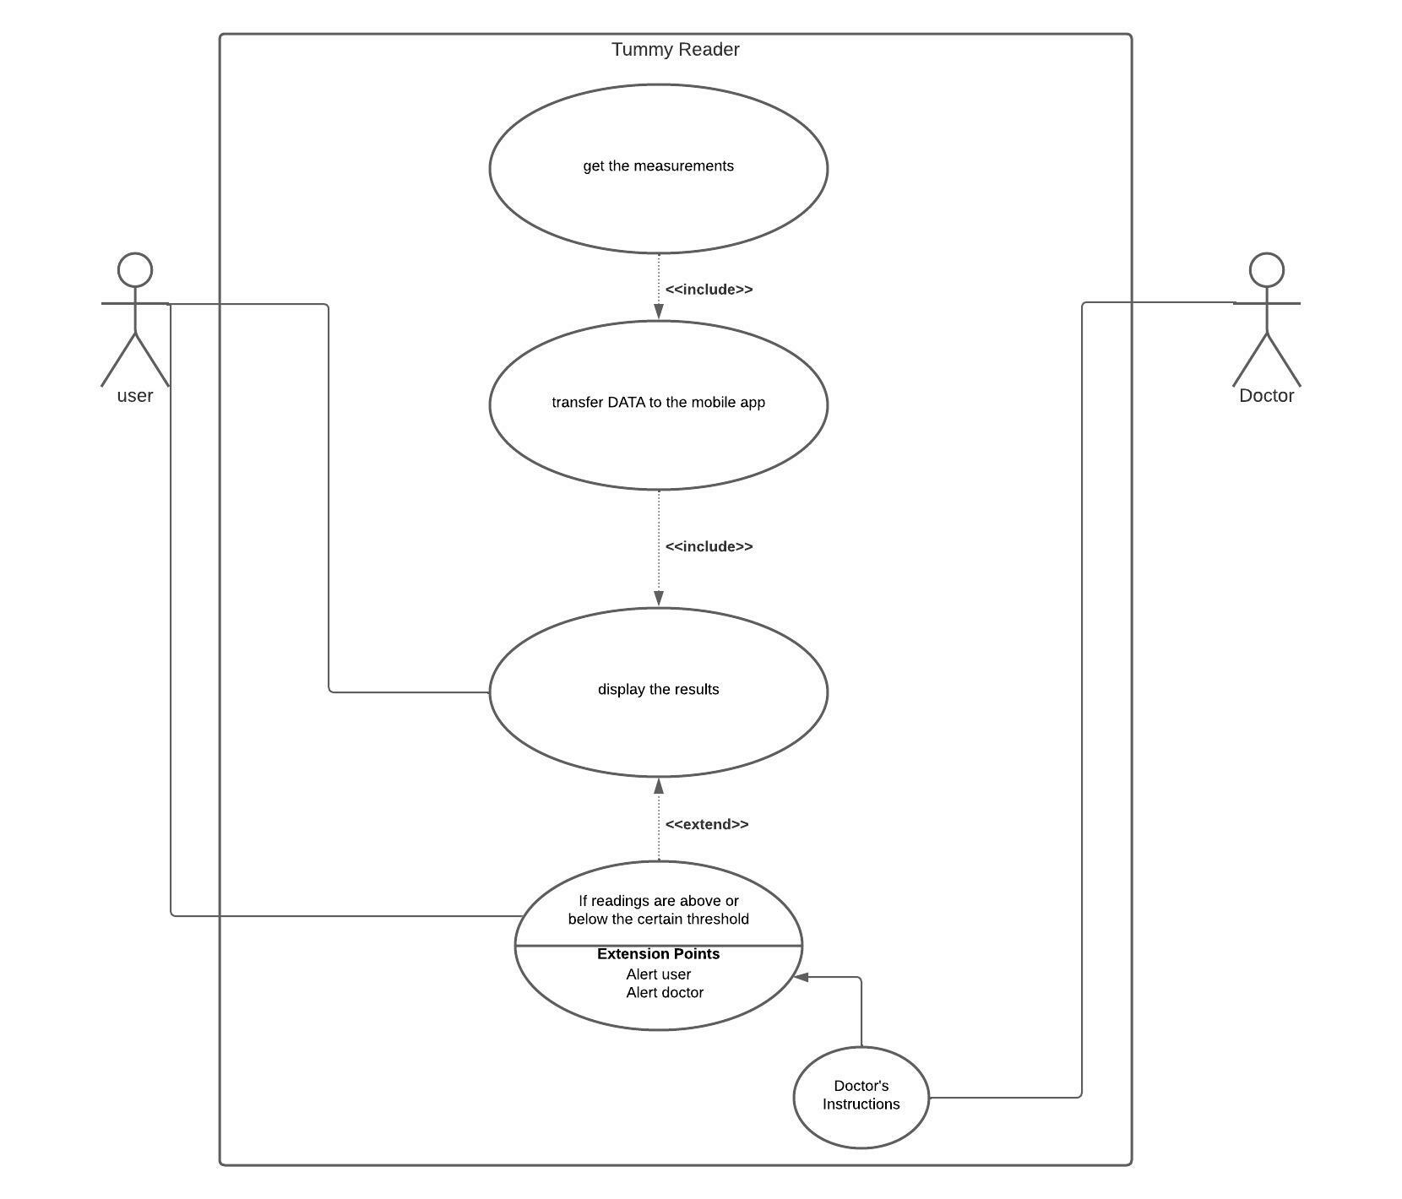
Use-Case Diagram

Slide 6
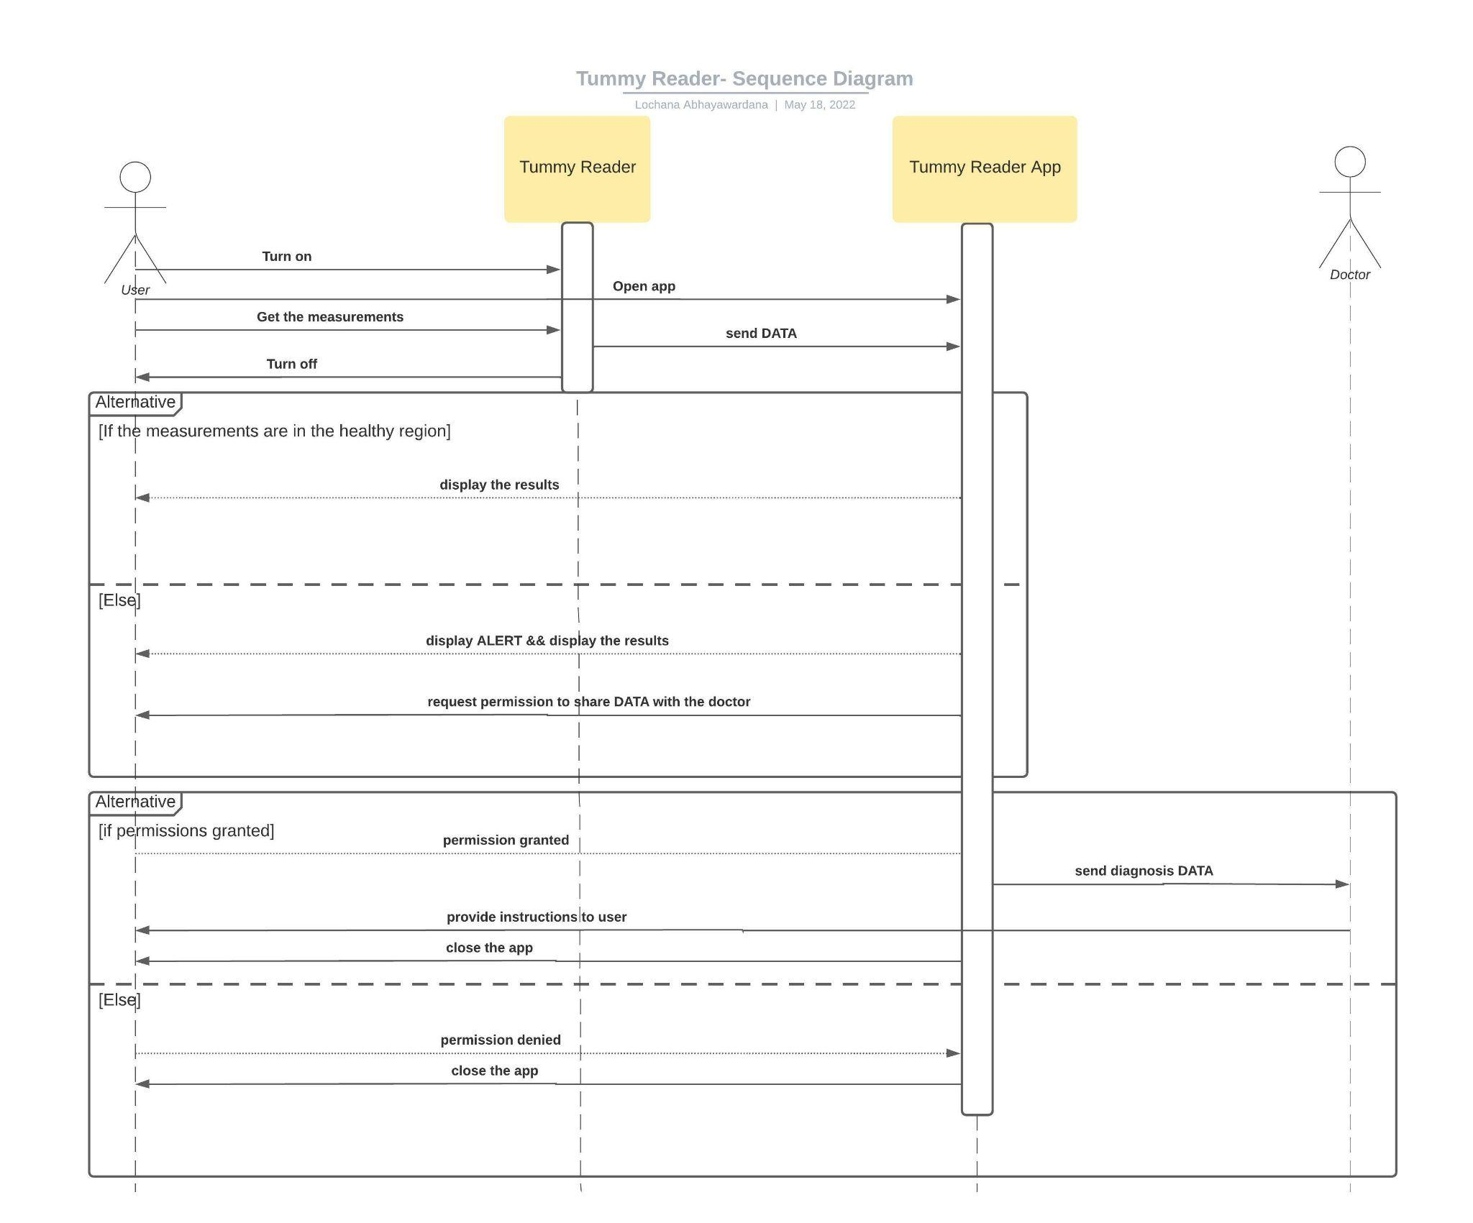
Sequence Diagram

Slide 7
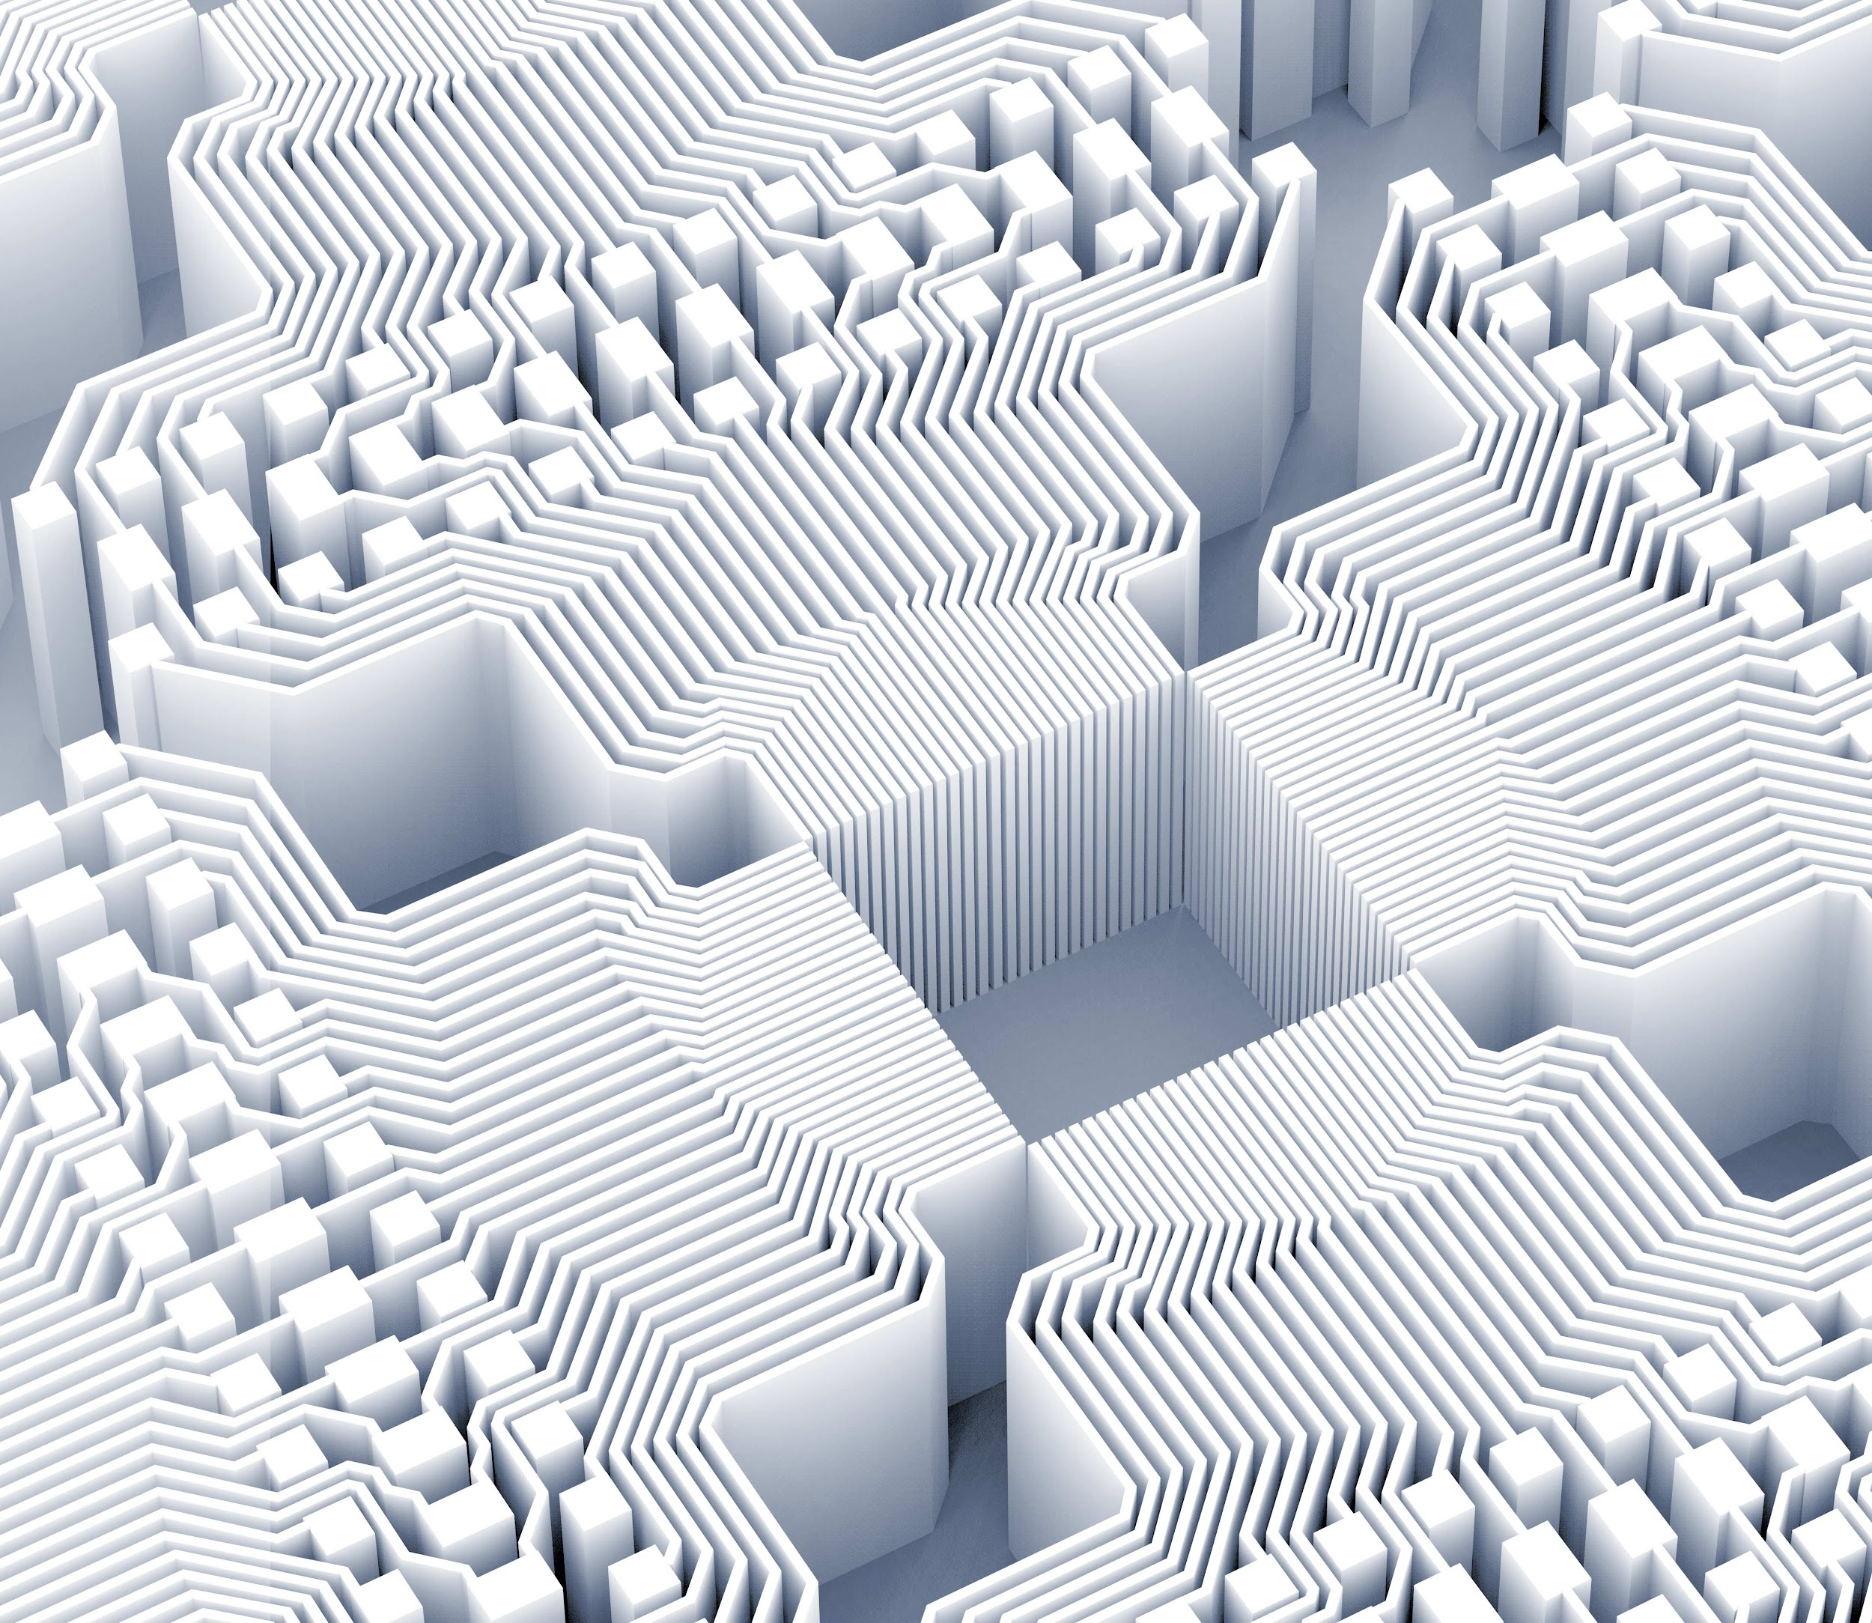
Thank you!

